Slide 1
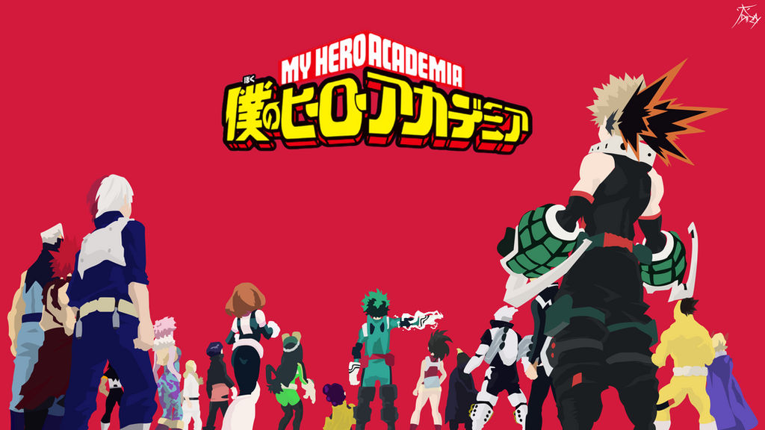

Fandoms in MHA
Alex Kimball
Jacky Irwin
Tessa Price

Slide 2

Background and Motivation
Notes:
Background and Motivation:
Reading and watching stories unfold is a past time that many people enjoy. People tend to enjoy gathering and discussing these stories that they are fan of. Every once in a while someone will come up Fanfic, spin off stories of their fandom, and share their stories with others. These stories tend to discuss their favorite pairing of characters or which pairing that they wish would come to fruition, which is known as 'shipping' or 'ships'. It is interesting to see how the ships shift or are embraced as the initial story develops further. One of the biggest fandoms that are in the Anime scene right now is My Hero Academia/Boku no Hero Academia.

Slide 3
Intro
Fandoms:
Universe created by someone that is followed by others
Fanfics:
Spin offs written by fans
Ships/Shipping:
Pairings of characters that the fans would like to see.

Slide 4

Project Objectives

Slide 5


The Primary Questions
Character with the most number of ships?
Characters most discussed?
Highest number of Hits?
Correlation between Characters, Ships and hits?

Slide 6
Want to Learn
Discernible patterns
Analyzing the patterns for possible future benefit

Slide 7

Benefits
Improving stories
Correct audience
More enjoyable

Slide 8

DATA

Slide 9
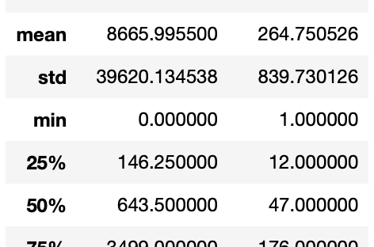
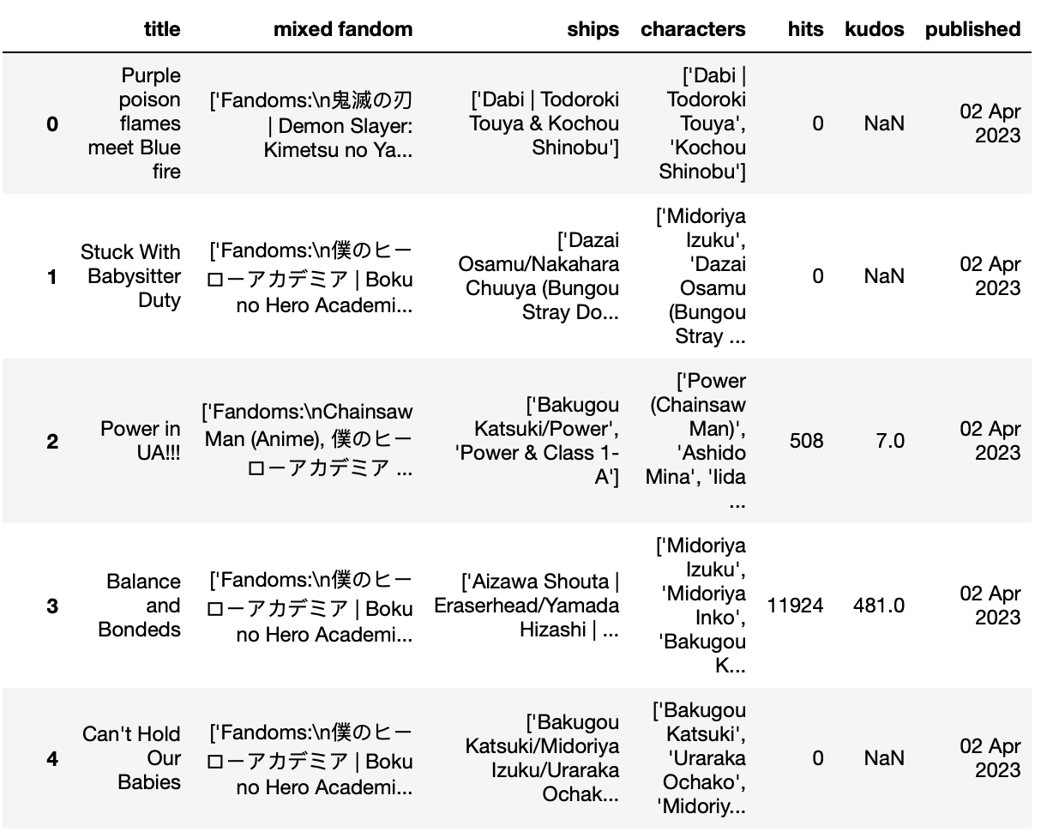
AO3:
Title
Mixed fandoms
Ships
Characters
Hits
Kudos
Published date

Slide 10
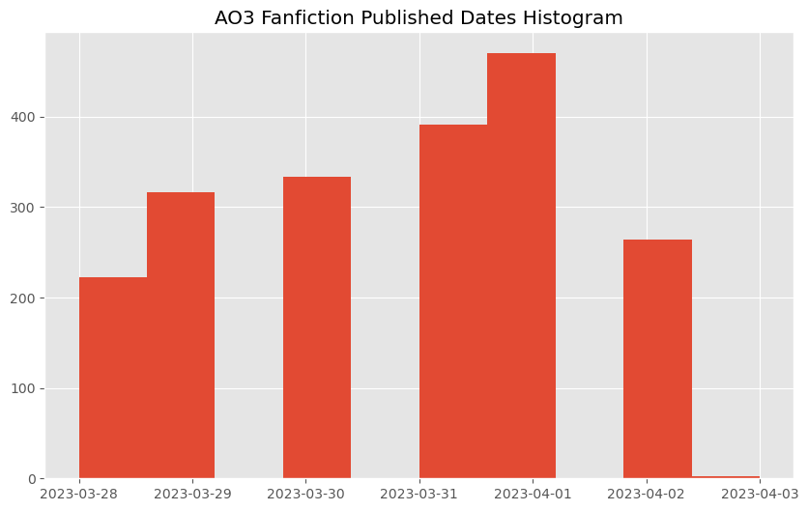
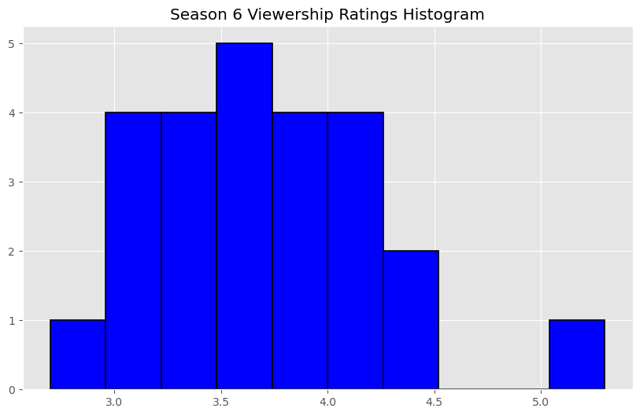
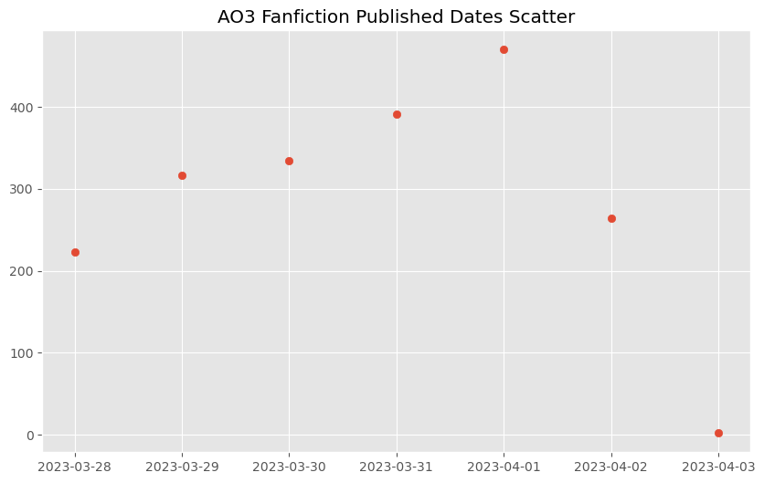
Span of our data
span of seven days
One episode release in span
No chapter release in span

Slide 11

Ethical Considerations

Slide 12
Stakeholders
Authors
Script writers
Fans
Viewers
Readers
Publishers
Directors

Slide 13
Incentives
Story improvement
Increased viewership
Increased engagement

Slide 14

Data Processing

Slide 15
Beautiful soup/Web scraping
#For loop going through the first 100 pages of My Hero Academia fanfic and making htmls
for x in range(1, 101):
url = f'https://archiveofourown.org/tags/%E5%83%95%E3%81%AE%E3%83%92%E3%83%BC%E3%83%AD%E3%83%BC%E3%82%A2%E3%82%AB%E3%83%87%E3%83%9F%E3%82%A2%20|%20Boku%20no%20Hero%20Academia%20|%20My%20Hero%20Academia%20(Anime%20*a*%20Manga)/works?page={x}’
try:
with urllib.request.urlopen(url) as response:
html = response.read()
html = html.decode('utf-8’)
with open (f'AO3_Page{x}.html', 'w', encoding="utf-8") as new_file:
new_file.write(html)
time.sleep(8)
except urllib.error.HTTPError as e:
if e.code == 429:
print('Too many requests!---SLEEPING---’)
print('we should restart on page', x)
print('we should restart with this url:', url)
Break
raise

Slide 16

Analysis

Slide 17

Exploratory analysis

Slide 18
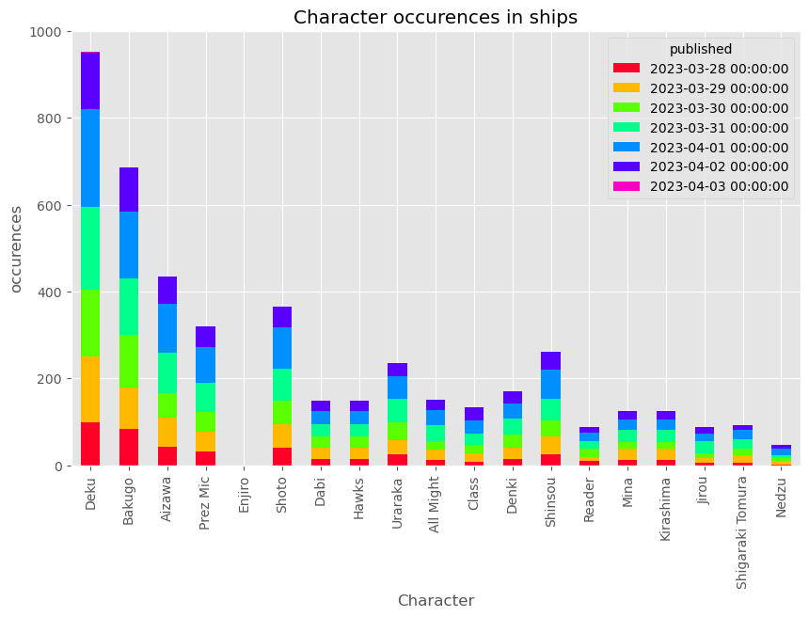
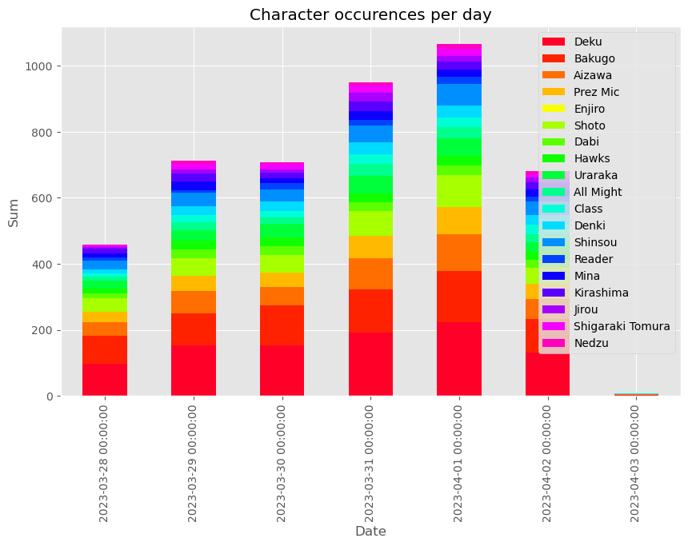
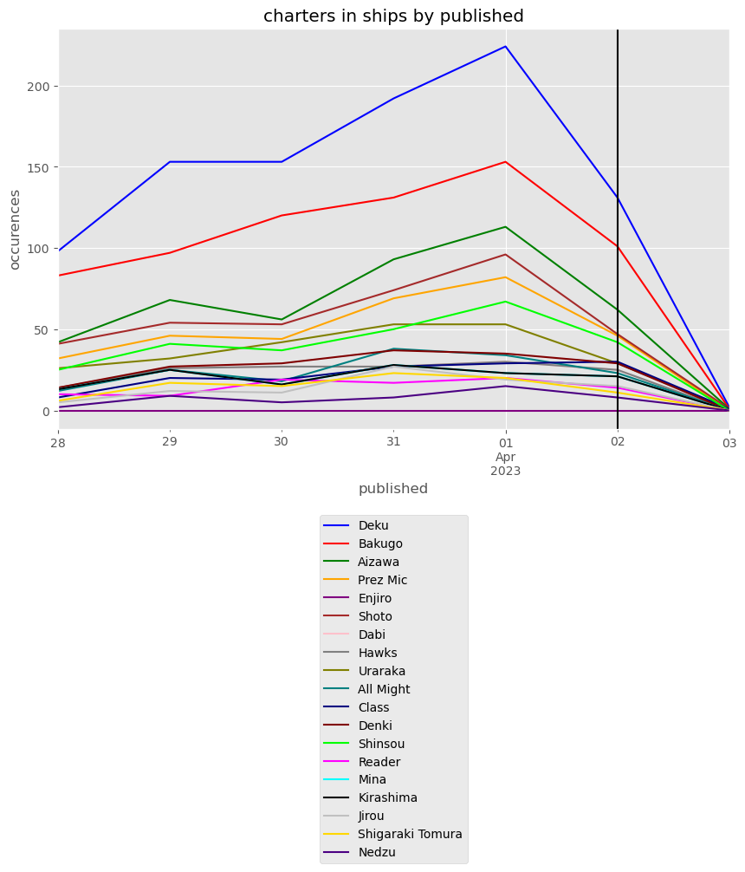
Character with the most ships?
Deku/Midoriya
Per day and overall
Top:
Character color date
Middle:
Date color character
Bottom:
Character by date

Slide 19
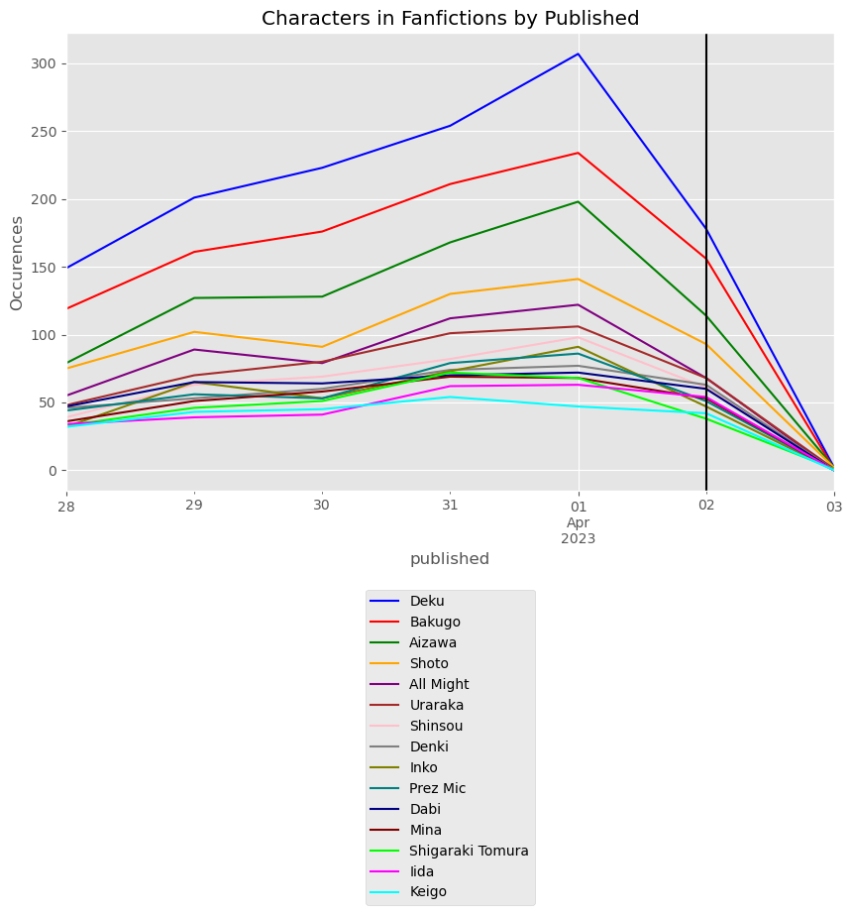
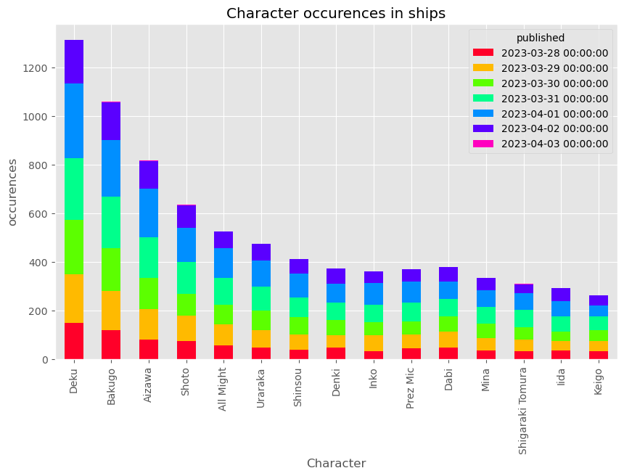
Characters most discussed?
Deku/Midoriya
Same as with most ships

Slide 20
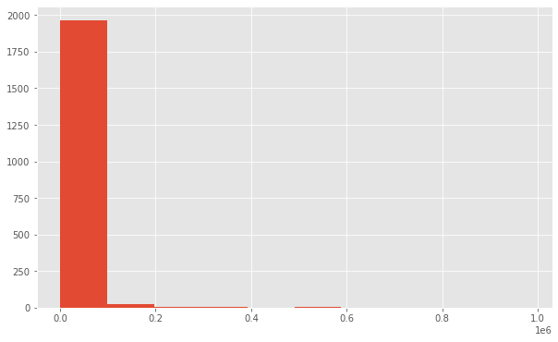
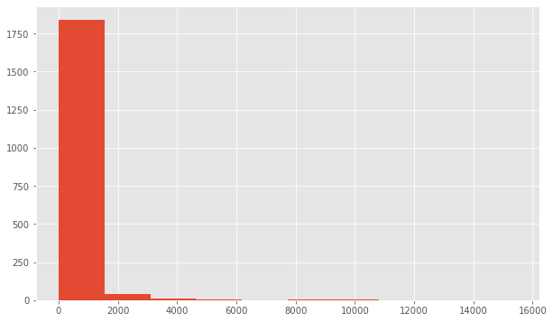
Kudos & Hits
Top:
Kudos
Bottom:
Hits

Slide 21

Analysis Methodology

Slide 22
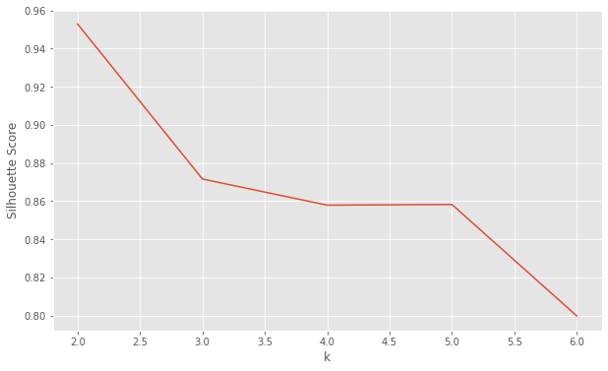
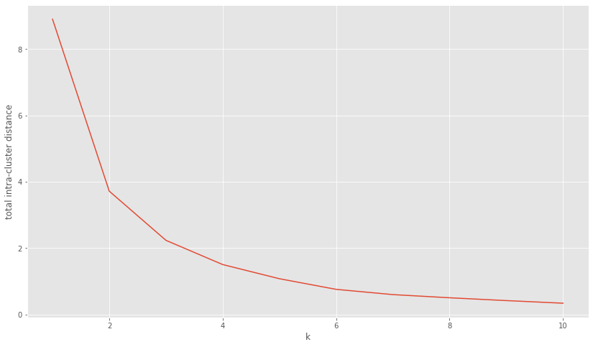
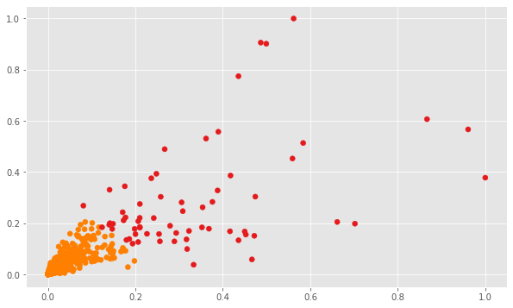
Kudos & Hits

Slide 23
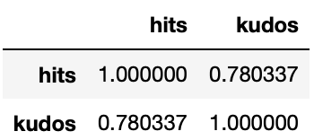
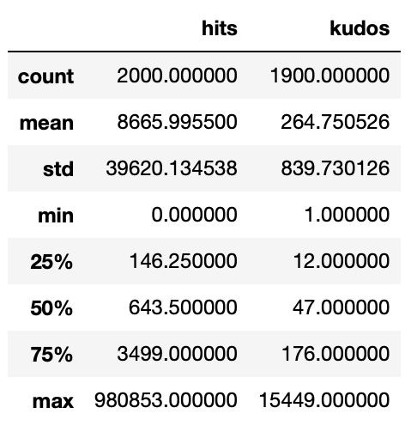
Highest number of Hits?

Slide 24
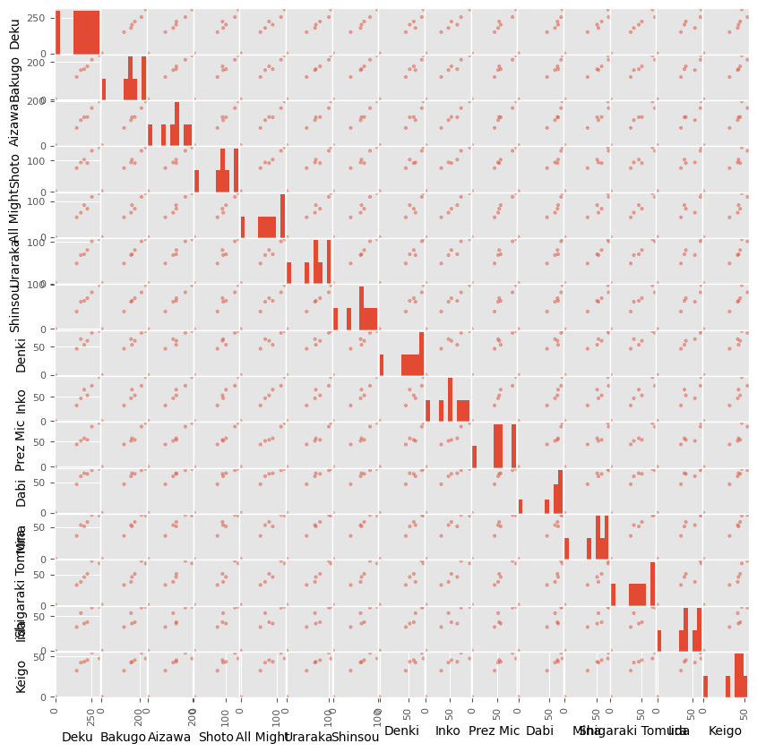
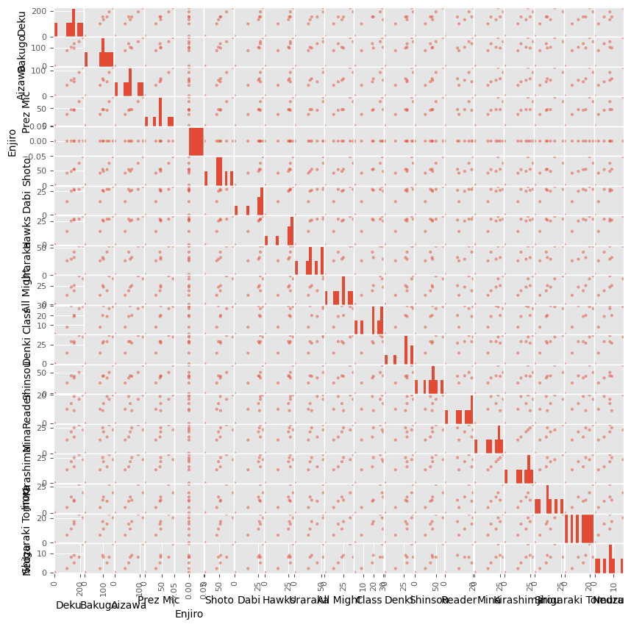
Scatter plot matrix
This shows they have a positive correlation with one another.
Top:
Top Characters
Bottom:
Top Ships

Slide 25
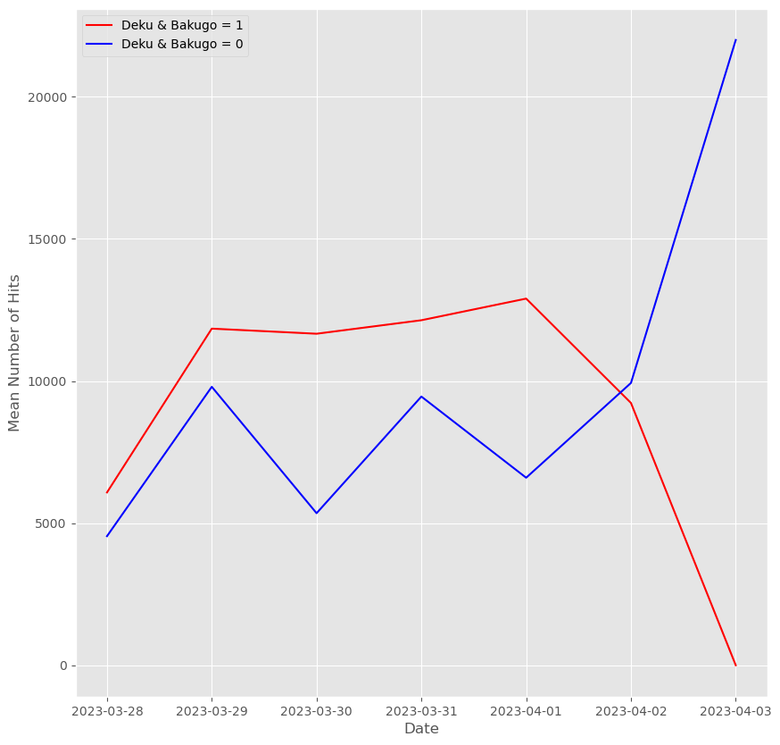
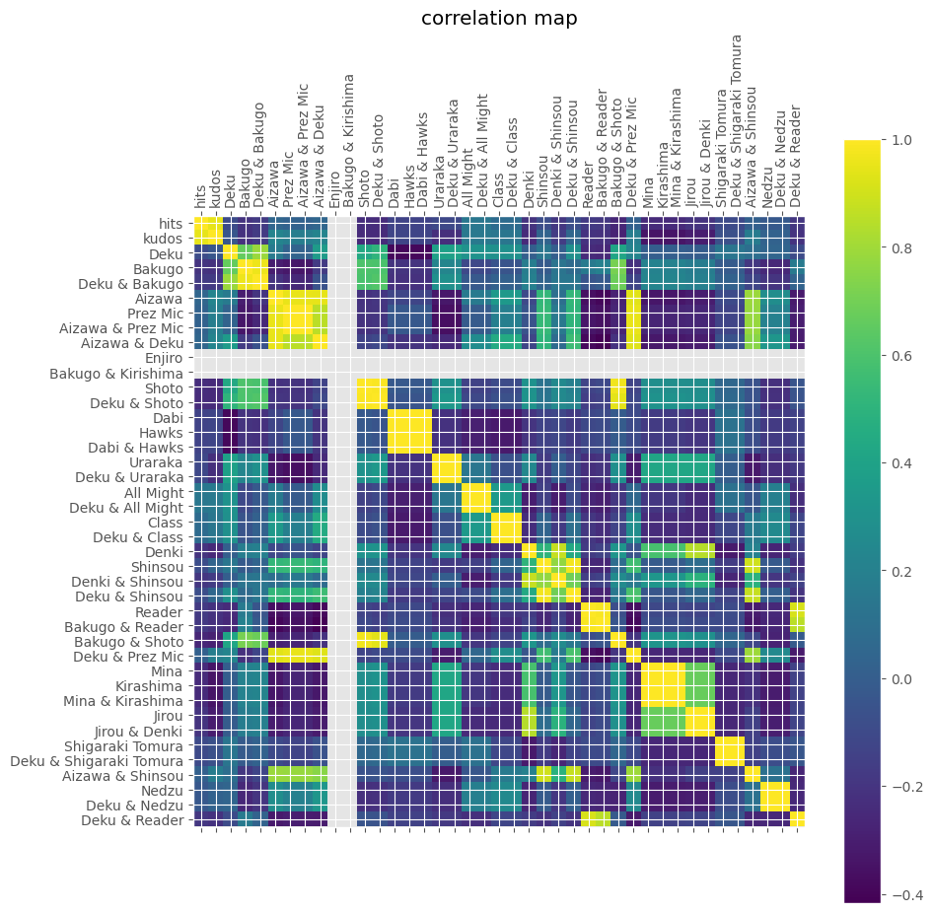
Correlation between Characters, Ships and hits?

Slide 26

Conclusion

Slide 27


Findings
DEKU is most
Aizawa correlation
Most hits was ‘Snapshots’

Slide 28
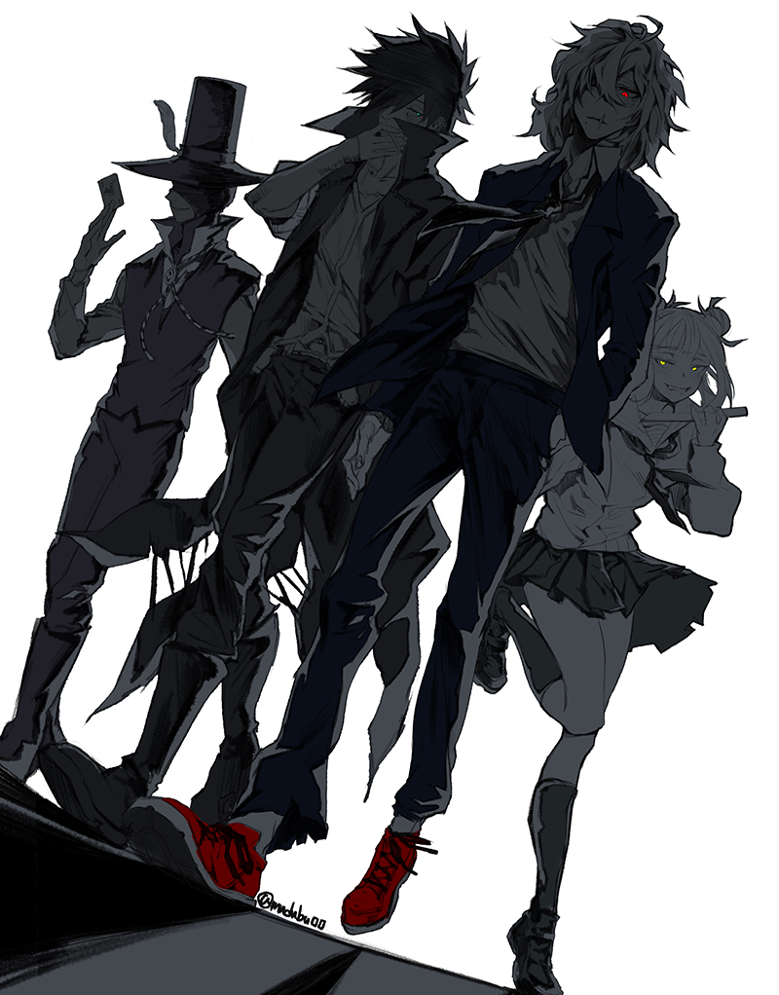
Next Time
Pull either more data or data that is more spread out so instead of pulling the first ten pages pull 1 page for every 250 pages or something like that.
Analyze more ships and characters
Analyze the crossovers

Slide 29
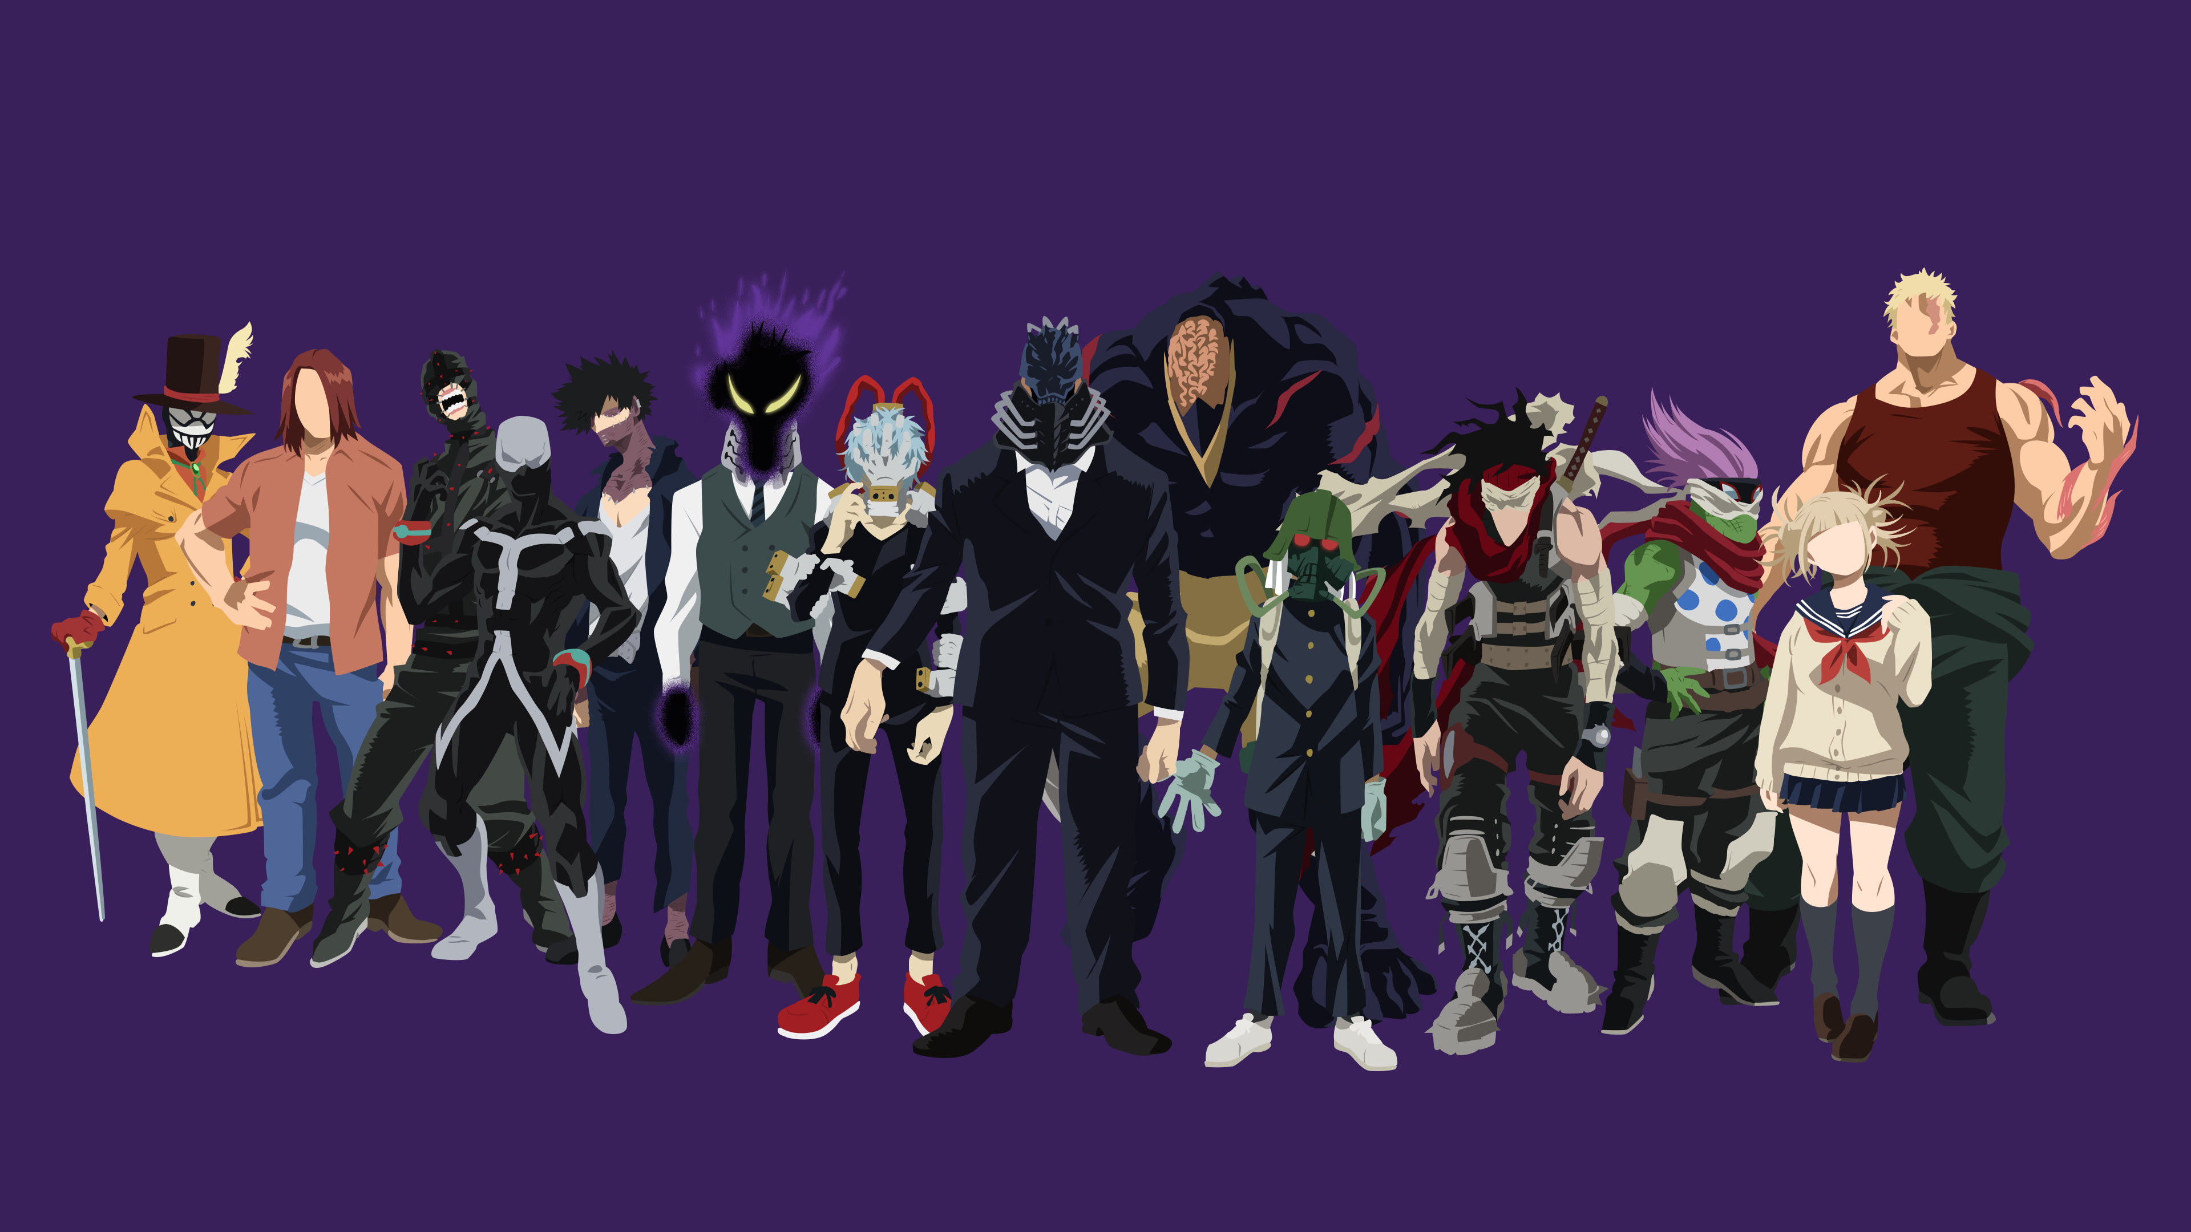
End

